Slide 1
Container Orchestration

Slide 2
Container Orchestrator Features
◆ Container Deployment / Provisioning
◆ Fault Tolerance
◆ Autoscaling
◆ Service Discovery

Slide 3
Container Orchestrators
◆ Container orchestrators
Kubernetes
Docker Swarm
Mesos Marathon
Amazon ECS . . . etc

Slide 4
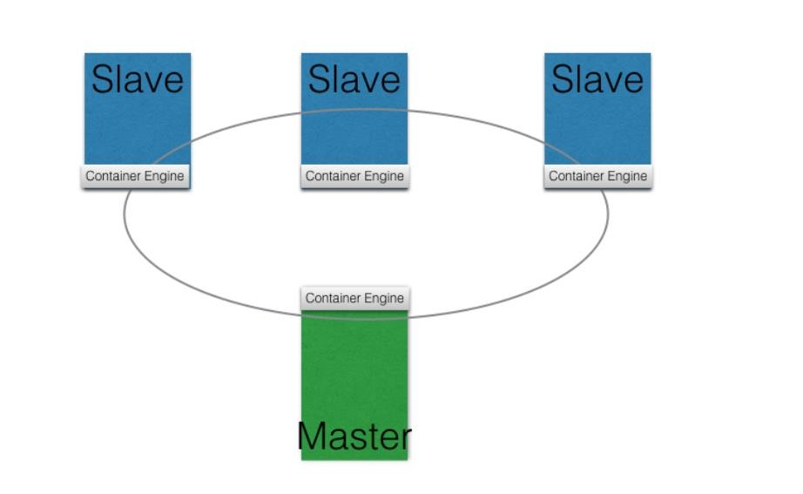
Master / Slave Architecture

Slide 5
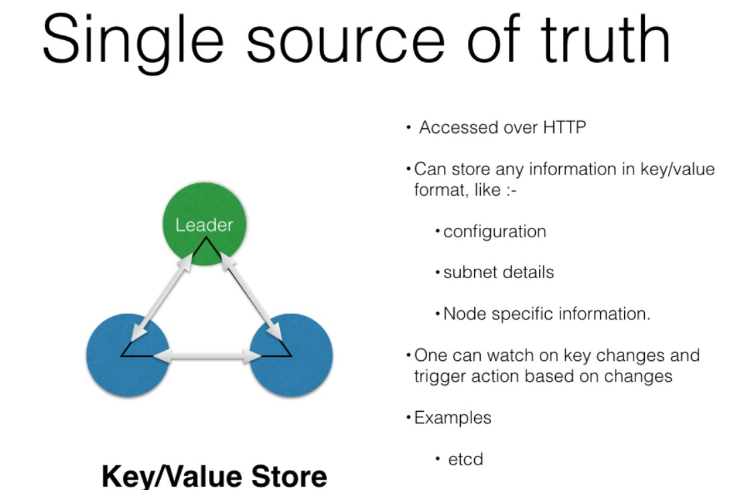
Key/Value Store

Slide 6
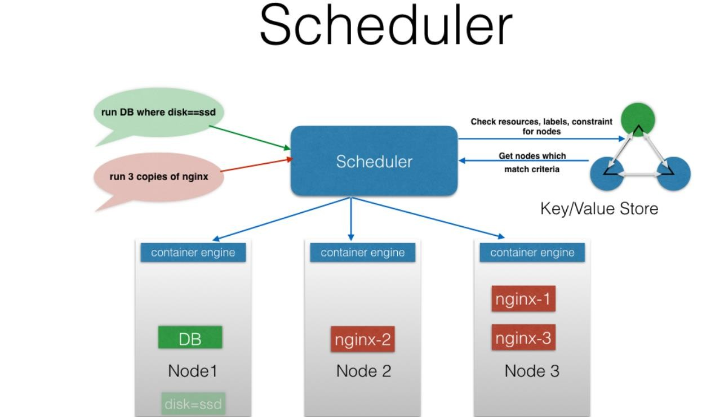

Slide 7
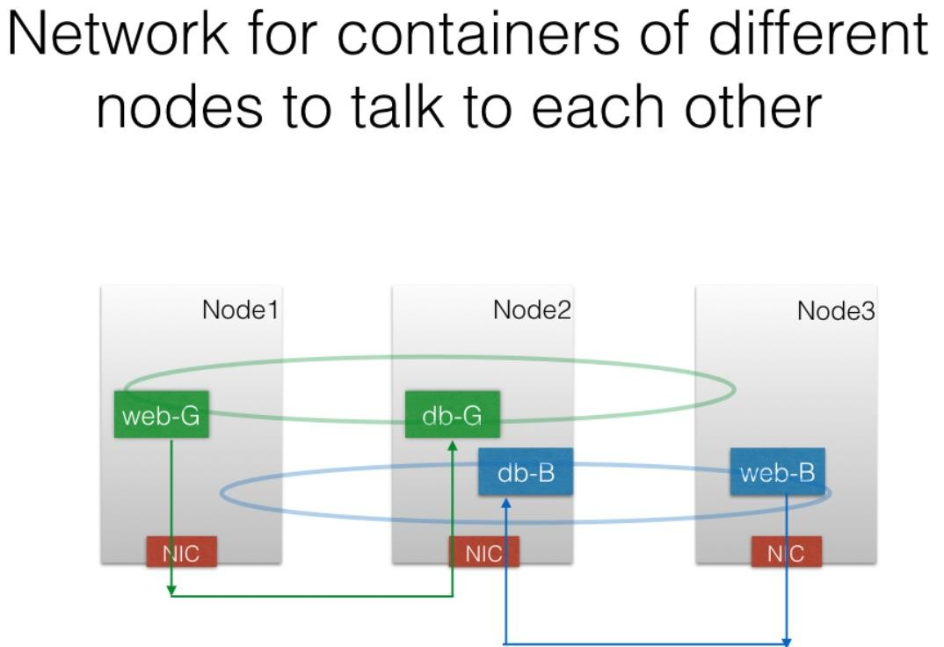

Slide 8
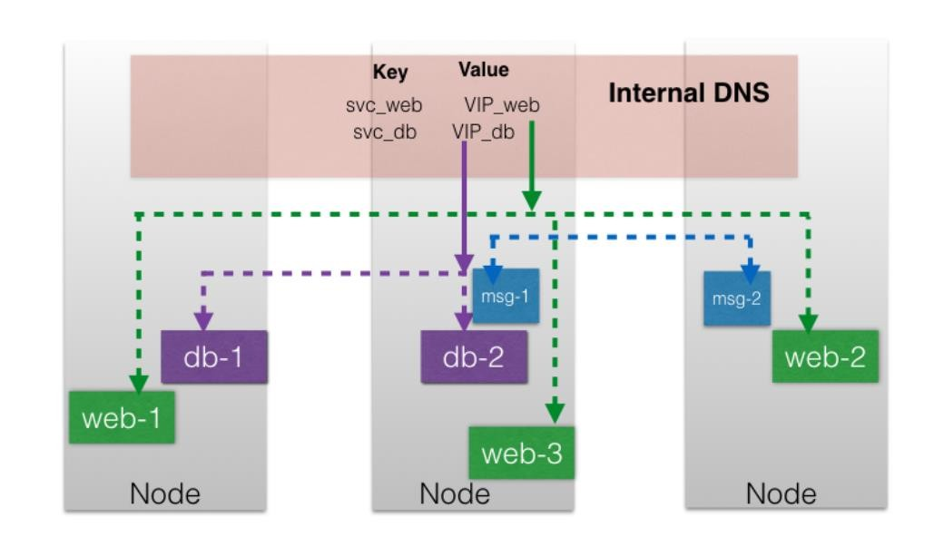
Service Discovery

Slide 9
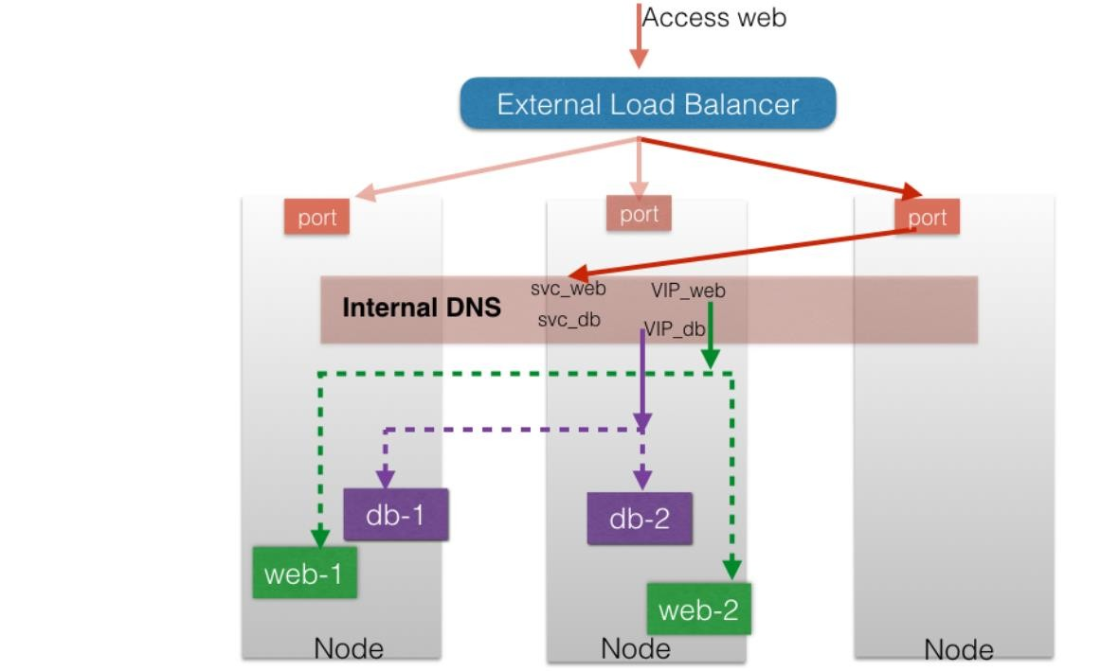
Access from External World

Slide 10
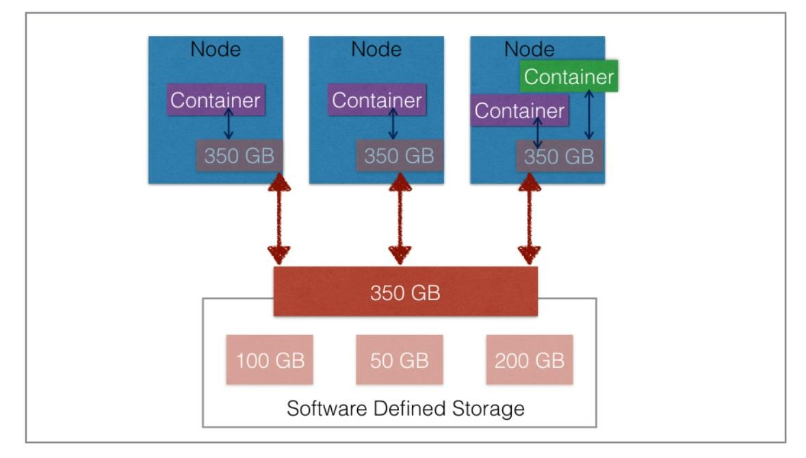
Access to External Storage

Slide 11
THANK YOU

